Slide 1

Customer Shopping Behavior Analysis
Uncovering key insights from transactional data to guide strategic business decisions.

Slide 2

Project Goals & Data Scope
Project Goal
Dataset Size
Key Features
Analyze 3,900 customer purchases to uncover spending patterns, product preferences, and subscription behavior.
3,900 Rows and 18 Columns, covering demographics, purchase details, and shopping behavior.
Age, Gender, Location, Category, Purchase Amount, Season, Previous Purchases, and Subscription Status.

Slide 3


Exploratory Data Analysis (EDA) in Python
Data Preparation Steps
Data Cleaning
Imputed 37 missing values in the Review Rating column using the median rating per product category.
Standardization
Renamed columns to snake_case for improved readability and documentation.
Feature Engineering
Created age_group and purchase_frequency_days columns for deeper analysis.
Database Integration
Loaded the cleaned DataFrame into PostgreSQL for structured SQL analysis.

Slide 4
Key Business Insights: Revenue & Spending
$157,890
$75,191
839
Male Revenue
Female Revenue
High-Spending Discount Users
Total revenue generated by male customers.
Total revenue generated by female customers.
Customers who used a discount but still spent above the average purchase amount.
Male customers contributed significantly more to total revenue than female customers.

Slide 5

Product Performance and Customer Ratings
Top 5 Products by Average Review Rating
Discount-Dependent Products
Product
Avg. Rating
Products with the highest percentage of discounted purchases:
Gloves
3.86
Hat: 50.00%
Sneakers: 49.66%
Sandals
3.84
Coat: 49.07%
Boots
3.82
Sweater: 48.17%
Pants: 47.37%
Hat
3.80
Skirt
3.78

Slide 6
Subscription and Shipping Insights
Shipping Type Comparison
Subscribers vs. Non-Subscribers
Repeat Buyers & Subscriptions
Express shipping users have a higher average spend ($60.48) compared to Standard shipping users ($58.46).
Non-subscribers have a slightly higher average spend ($59.87) than subscribers ($59.49), but contribute more total revenue ($170,436).
Customers with >5 purchases are more likely to subscribe (958 repeat buyers are subscribers vs. 2,518 non-subscribers).

Slide 7

Customer Segmentation
Customers were classified into three segments based on their purchase history:
Returning — 701
Loyal — 3,116
New — 83
The majority of the customer base falls into the "Loyal" segment, indicating strong retention.

Slide 8
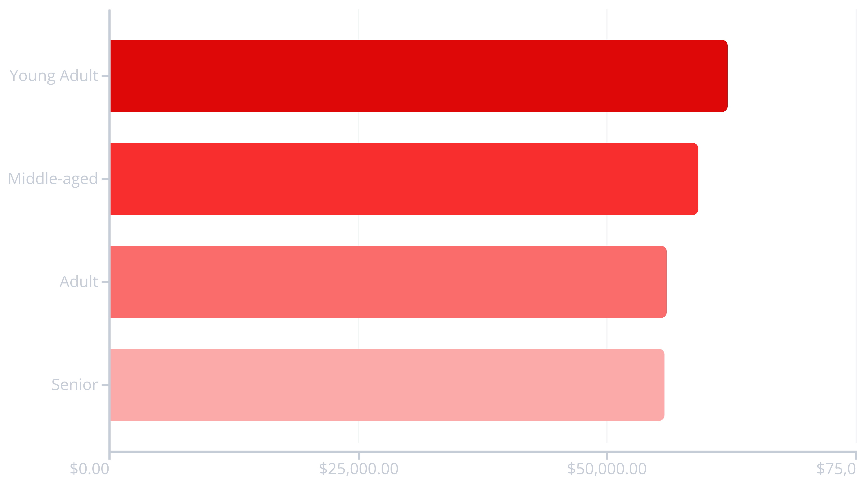
Revenue Contribution by Age Group
Young Adults generate the highest total revenue, followed closely by the Middle-aged group.

Slide 9

Top Products Across Categories
Accessories
Jewelry (171 orders)
Sunglasses (161 orders)
Belt (161 orders)
Clothing
Blouse (171 orders)
Pants (171 orders)
Shirt (169 orders)
Footwear
Sandals (160 orders)
Shoes (150 orders)
Sneakers (145 orders)
Outerwear
Jacket (163 orders)
Coat (161 orders)

Slide 10
Strategic Business Recommendations
Boost Subscriptions
1
Promote exclusive benefits to increase subscriber conversion and retention.
Customer Loyalty Programs
2
Reward repeat buyers to solidify the "Loyal" segment and encourage further spending.
Review Discount Policy
3
Carefully balance sales boosts from discounts with necessary margin control.
Targeted Marketing
4
Focus campaigns on high-revenue age groups (Young Adult, Middle-aged) and Express Shipping users.
Product Positioning
5
Highlight top-rated and best-selling products in marketing campaigns for maximum impact.

